Slide 2


Introduction to the Microsoft AI School
Velin Georgiev
@VelinGeorgiev
/in/velingeorgiev

Slide 3
Overview
https://aischool.microsoft.com
Predefined courses
Path builder
AI Demos

Slide 4
How an AI course looks like?
Complete cards where …
Read an article
Watch a video
Do exercise

Slide 5
Your first course
AI Bootcamp - http://bit.ly/lkailearn
Long courses also available - http://bit.ly/lkailong

Slide 6






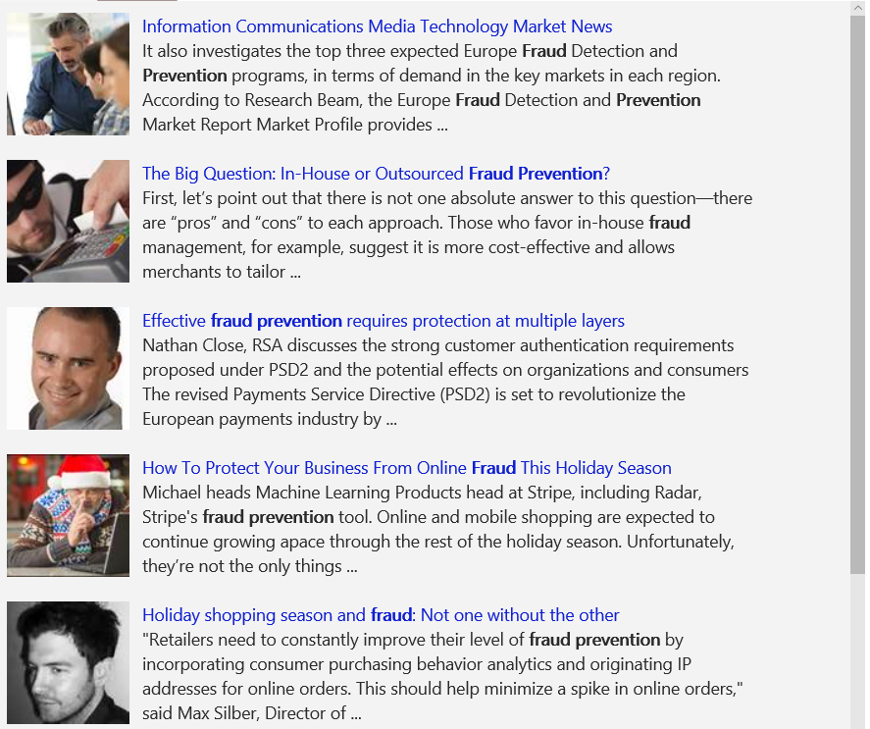
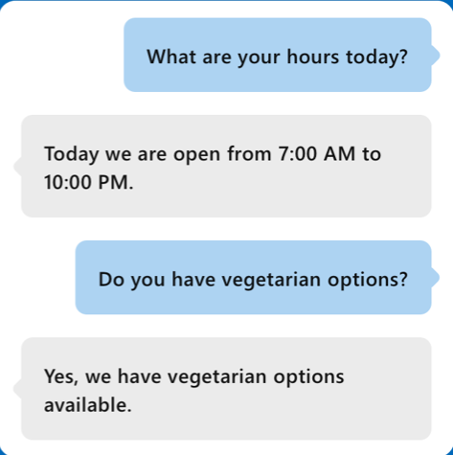
What is next?
Vision
Speech
Language
Knowledge
Search
What is in the image or video?
Give me directions to the nearest local branch
Play today’s customer call recording
QnA Pair of this site?
Search for ‘fraud prevention’
Intelligent Image insights
Speech to text
Natural Language Processing
Automatic extraction of questions and answers
Intelligent web search
Information Communications Media Market News
It also investigates the top three expected Fraud Detection and Prevention programs, in terms of demand in key markets…
Intent: PlayCall
Content: Customer#
DateTime.date: today
The Big Question: In-House or Outsourced Fraud Protection?
First, let’s point out that there is not one absolute answer—there are “pros” and “cons” to each. Those who favor in-house…
Category | People; 5 faces
Adult/Racy? | False/False
Dominant colors
Accent color
Convert spoken audio to text
How to Protect Your Business from Online Fraud this Holiday Season
Michael heads fraud prevention tool. Online and mobile shopping are expected to continue growing apace…
Computer Vision
Speech Service
Language Understanding
QnA Maker
Bing News Search
Convert text to spoken audio
Now Playing
Extract intent of user
11/29/2016 Customer Call

Slide 7
What tools do I need?
Depends … and AI School can help you on your choose.
Visual Studio Code hands-on
Microsoft Cognitive Toolkit
Google TensorFlow
Azure notebooks

Slide 8
Microsoft Learn
http://bit.ly/lkmslearn

Slide 9
Q & A

Slide 10
Thank you!

